Slide 1
Object-Oriented Analysis and Design
Chapters 12-14: introduction to design

Slide 2
What will we learn?
Introduction to the Logical Architecture and layers
How to use UML package diagrams
Understanding the static versus dynamic object modeling

Slide 3
Moving from Analysis to Design
So far we have studied …
How to create use cases
How to create a Domain Model
How to create SSDs and Operations Contracts
These are the main tools in OOA, i.e. they help explore and define what the system does
We will now move to design, where we define how the system works
Note that this may still be part of the Agile UP process: Analysis and design are occurring at the same time as requirements are refined

Slide 4
Analysis vs Design
A bad domain model will mean bad communication of the what the system is; a bad design model often leads to a bad implementation
Making the correct choices now becomes more important
Here is where iterative development can help – constant feedback and requirements enhancement can help the design evolve correctly
Note the initial requirements analysis phase may be very short, and of course coding can start immediately

Slide 5
Artifacts Interaction
We are now ready to begin to build the Design Model artifact
Key influences: Most of the artifacts we have already worked on influence the Design Model:
Use-Case Model
Vision
Supplementary Specification
Glossary
Domain Model
The Logical Architecture (LA) is part of the Design Model artifact, and is often shown using package diagrams (we will learn about these shortly)
Note the interaction diagrams (which are dynamic) and class definition diagrams (which are static) are also part of the Design Model artifact

Slide 8
Logical Architecture
The Logical Architecture is a large-scale organization of the software classes into packages, subsystems, and layers.
Logical: Implies that there is no decision about how these elements are actually deployed on physical systems, i.e. how many computers will host the system, how they are connected, etc.
The LA organizes the software classes into layers, which are just collections of classes
Each layer is made up of similar classes that have similar responsibilities for a major aspect of the system
Normally, the higher or upper layers call upon the services of the lower layers, but not viceversa

Slide 9
Logical Architecture: The Layer Model
Name | Purpose
User Interface (UI) | Software objects that directly interact with the user, e.g. GUI interface forms
Application Logic and Domain Objects | Software objects representing domain concepts that fulfill application requirements, such as calculating a total
Technical Services | General purpose objects and subsystems that provide supporting technical services, e.g. error logging or interfacing to a database. Usually reusable objects that are used across multiple applications
These are types of layers – the actual model may have more

Slide 10
Logical Architecture
In a strictly layered model, each layer only calls the services of the layer below it
For information services, the layered model is usually considered relaxed
For example, the GUI may utilize logging, or a form may directly access a database for a query
We will primarily concentrate on the middle layer, the Domain or Application Logic layer
For UI, we will primarily be concerned with how it interacts with the middle layer

Slide 11
UML Package Diagrams
We saw this concept when we were developing domain models – it is a way to organize the model into sub-models, with a “folder” notation for easier reading
Often used to illustrate the logical architecture
Model a layer as a package
The UML package diagram provides a way to group elements – can be used to group classes, other packages, etc.
Common to show dependency between packages – use a UML dependency line (dashed arrow pointing towards depended-on package)
UML package provides a namespace, which allows classes to be defined differently in different packages
Some UML CASE tools will reverse engineer code into packages

Slide 14
Design with Layers
The key benefit is that objects and classes are separated into cohesive units
This reduces complexity – less coupling of objects
We will see later that this is a good thing
For us, the key question will be how to design the objects that make up the Application Layer in an OOD manner
The basic approach is to define software objects with names and information similar to the real-world domain (Domain Model), and assign application logic responsibilities to them
These types of software objects are called Domain Objects
Represents something in the problem domain space, and has related application of business logic
Often the Application Logic layer is called the Domain Layer for this reason

Slide 15
Domain Layer and Domain Model
We look to the Domain Model for inspiration for the names and classes that will make up the Domain layer
Note: Not all conceptual classes in the Domain Model need to have classes in the Domain Layer
This is why we do the Domain Model – it helps close the gap between the software system and the real world model it is representing
Also very useful to name objects and associations after their real world counterparts – easier to comprehend the software

Slide 17
Layer Do’s and Don’ts
Don’t show external resources (like a database) in a layer at the bottom of the layer diagram – these resources should be included in the layer diagram as separate entities within an existing layer (e.g. the Technical Services)
Model – View Separation: Don’t put application logic in UI objects, and don’t let non-UI objects reference UI objects
Traditionally, the term model refers to the Domain Layer while the term view refers to the UI layer
Generally, model objects do not have direct knowledge of view objects, but this can be relaxed.
For example, in the POS, the Sale object should not directly send a message to a GUI window (but of course the other way is okay)
This helps promote re-use by not connecting domain objects to applications (UI objects)

Slide 18
SSDs, System Operations, Layers
Recall that SSDs were created from use cases to help explain how the system handles input events from the user
In these diagrams, the internal objects of the UI layer are usually hidden, although in the actual design there will probably be some kind of GUI or web page to gather the input
Normally, these UI objects will then forward the input information to objects in the Domain (or Application) Layer for processing
These are the system event messages we see in the SSDs
Example: In our POS system, if the Cashier is entering the items on a terminal (touchscreen or keyboard), there may be a Java Swing object ProcessSaleFrame that captures the information from the Cashier and forwards it to the Register
See next slide for a diagram

Slide 20
Logical Architecture for POS and Monopoly
The preceding diagram suggests a logical architecture for the POS system; we will study this in more detail in Chapter 34 after we expand our knowledge of OOD
But the LA shown on the previous slide would actually work for the first “cash payment” only iteration of the POS
For Monopoly, the LA would not really show anything useful –
It is a very simple UI, Domain, Technical Services architecture
See next slide for a more detailed view of what the POS LA will look like in our next iterations

Slide 22
Designing Objects
There are two kinds of object models: dynamic and static
Dynamic models help design the logic (i.e. the behavior) of the code or methods
These are the UML interaction diagrams (sequence or communication) we have seen
Static models help design the definition of packages, class names, attributes, and method signatures or operations (names and input parameters, return values – not method bodies)
These are the UML Class diagrams
Both types of models are usually created together in Agile UP
Can start with dynamic model and then move to static to fill in details
Dynamic models tend to be more challenging and useful – they explain the behavior, and will reveal the software objects that need to exist to make the behavior happen, as well as the messages/methods that allow these objects to communicate

Slide 23
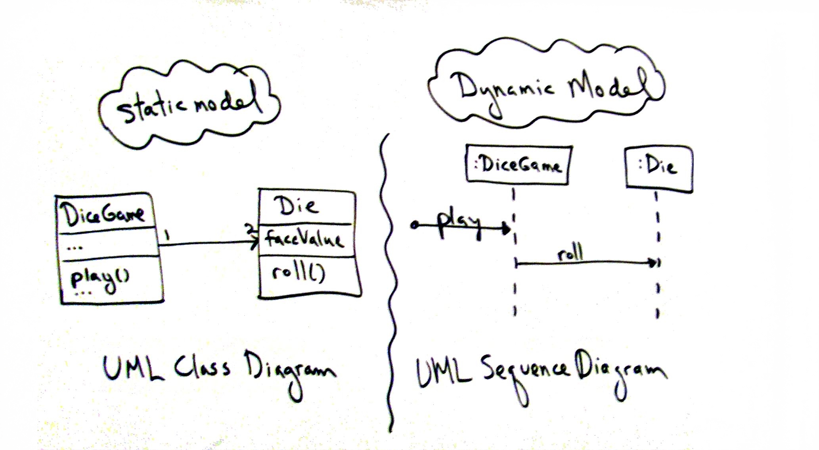

Slide 24
Designing Objects (cont.)
It is during the dynamic model creation stage that responsibility-driven design principles (like GRASP) are used
Recall that one the critical aspects of OOD was how to assign responsibilities to the objects in our design – this is essentially what the GRASP principles help with
Basic process: For each system event, create software classes (using the Domain Model for inspiration) that will be responsible for handling the event
For static models, the most common tool is the UML class diagram
Often created in parallel with the dynamic models
Organized into packages, as we have already seen
Remember, UML is a tool, not the actually design skill. Anyone can draw a UML diagram, but creating a good OO design is more challenging

Slide 25
Object-Oriented Design: Overview
Start with the use cases, Domain Model (possibly), SSDs, operations contracts (possibly)
Select a system operation (from the SSD, possibly detailed in an operations contract)
Using design patterns (like GRASP or GoF), or general experience, create software classes that will allow the system to handle the responsibilities of the system operation
Usually start with a dynamic model, like an sequence diagram or communication diagram
The operations contract or use case will describe the “responsibilities” – i.e. what the system is supposed to do, or what changes in the system
Use the Domain Model to inspire software objects that will create the desired behavior

Slide 26
Design Patterns: Introduction
In software engineering, a design pattern is a general reusable solution to a commonly occurring problem
Note: Not a code template or a reusable module
These are descriptions for how to solve a problem
The problems addressed by design patterns are commonly occurring problems in software design
We will study two groups in this course:
GRASP: General Responsibility Assignment Software Patterns (or Principles)
GoF: Gang of Four Patterns, widely considered the fundamental patterns for OOD
These will provide us with guidance on how to assign responsibilities to objects we want to design

Slide 27
The Model-View-Controller (MVC) Architecture
Very common logical architecture, similar to what we just saw
The View is the UI layer – it contains all the GUI objects, and has very little application logic
Passes information down
The Model – this is the layer that contains all of the logical functionality of the system – what it actually does
The Controller – this is the “glue” layer between the View and the Model.
Takes requests from the View, passes to the Model
Takes information from the Model, passes to the View for display
This architecture is popular because it promotes reuse of components

Slide 28
Takeaways from Chapter 12, 13, 14
Understand the logical architecture and the three main types of layers
Understand the relationship between Domain Model and Domain Layer
Understand the two types of design models (static and dynamic)

Slide 29
Next …
GRASP: General Responsibility Assignment Software Patterns – Chapter 17

